Slide 1
Chongqing University of Technology
ATAI
Advanced Technique of Artificial Intelligence
Chongqing University of Technology
Text Classification with Negative Supervision（ACL 2020 ）
汇报人：彭展望
Code : https://github.com/21335732529sky/negative_supervision

Slide 2
Outline
Introduction
Method
Experiment
Conclusion

Slide 3
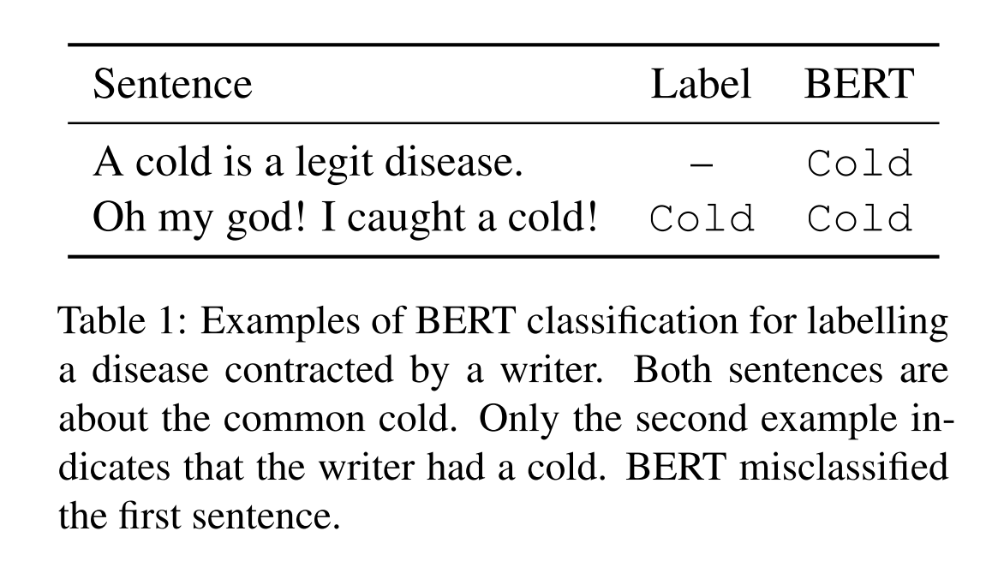
Introduction

Slide 4
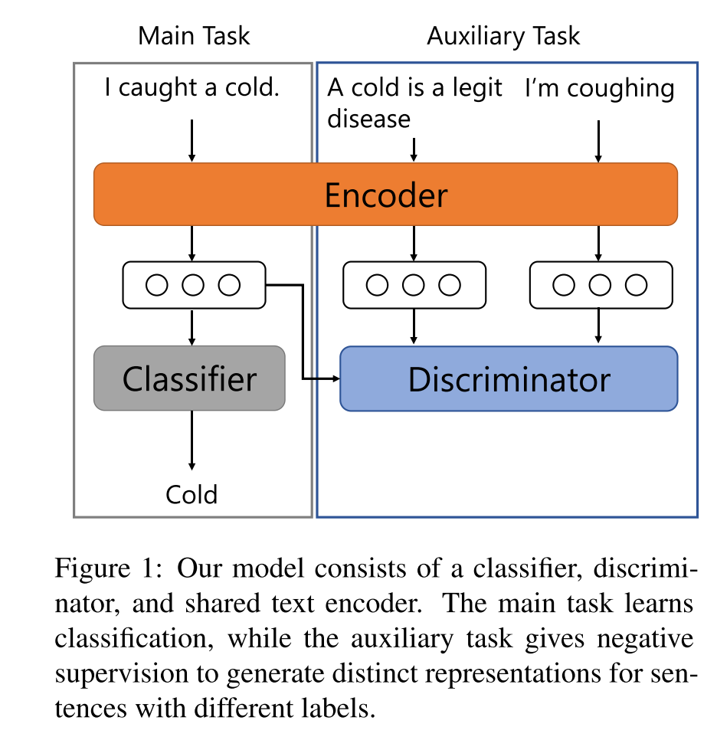
Method
Multitask Learning Framework:

Slide 5
Method
Main Task:

Slide 6
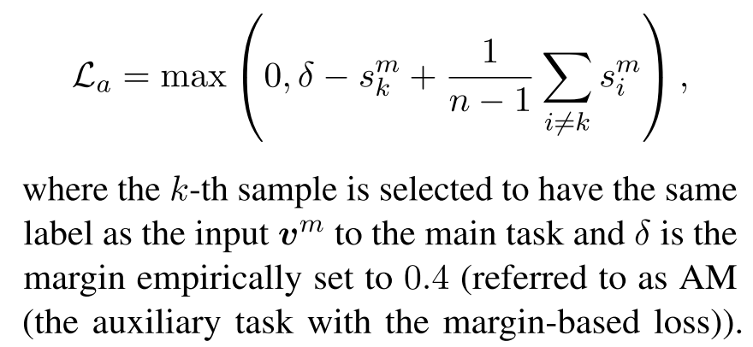
Method
Auxiliary Task:
First:
Second:

Slide 7
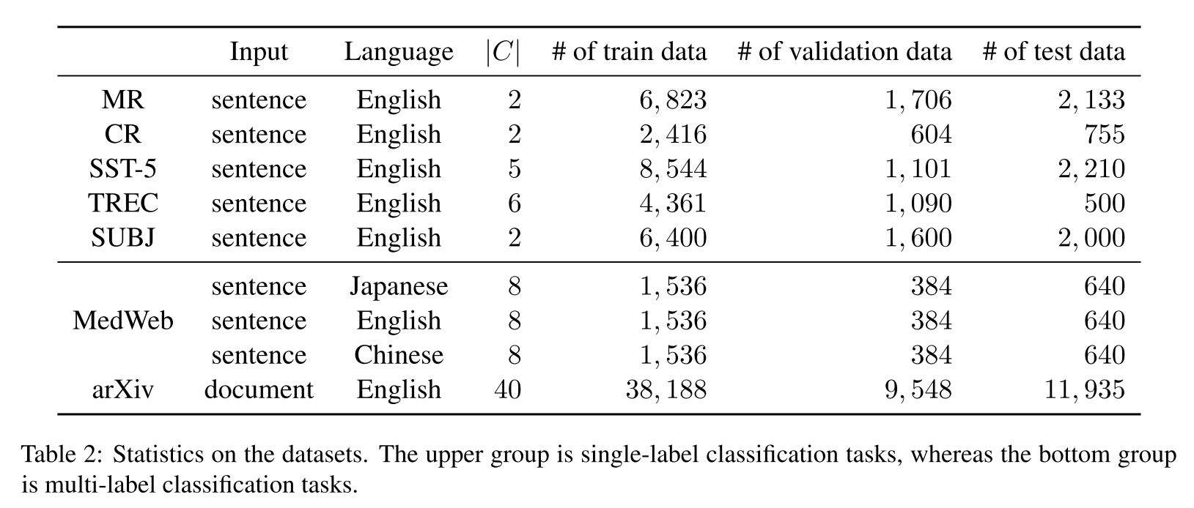
Dataset

Slide 8
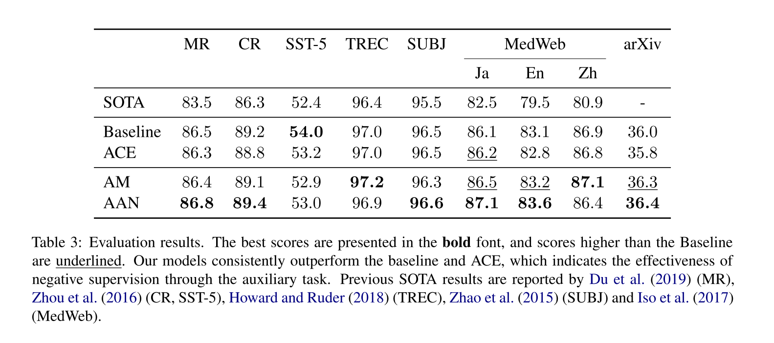
Experiment

Slide 9
Thanks

